Slide 1


Application Layer
COMPSCI 453 Computer Networks
Professor Jim Kurose
College of Information and Computer Sciences
University of Massachusetts
Principles of network applications
Web and HTTP
E-mail, SMTP, IMAP
The Domain Name System: DNS
P2P applications
video streaming, CDNs
socket programming with UDP and TCP
Class textbook:
Computer Networking: A Top-Down Approach (8th ed.)
J.F. Kurose, K.W. Ross
Pearson, 2020
http://gaia.cs.umass.edu/kurose_ross

Slide 2

E-mail
user
agent
Three major components:
user agents
mail servers
simple mail transfer protocol: SMTP
User Agent
a.k.a. “mail reader”
composing, editing, reading mail messages
e.g., Outlook, iPhone mail client
outgoing, incoming messages stored on server
mail
server
user
agent
SMTP
mail
server
user
agent
SMTP
SMTP
user
agent
mail
server
user
agent
user
agent
outgoing
message queue
user mailbox

Slide 3
E-mail: mail servers
user
agent
mail servers:
mailbox contains incoming messages for user
message queue of outgoing (to be sent) mail messages
SMTP protocol between mail servers to send email messages
client: sending mail server
“server”: receiving mail server
mail
server
user
agent
SMTP
mail
server
user
agent
SMTP
SMTP
user
agent
mail
server
user
agent
user
agent
outgoing
message queue
user mailbox

Slide 4
SMTP RFC (5321)
“client”
SMTP server
“server”
SMTP server
uses TCP to reliably transfer email message from client (mail server initiating connection) to server, port 25
direct transfer: sending server (acting like client) to receiving server
three phases of transfer
SMTP handshaking (greeting)
SMTP transfer of messages
SMTP closure
command/response interaction (like HTTP)
commands: ASCII text
response: status code and phrase
initiate TCP
connection
RTT
TCP connection
initiated
220
SMTP handshaking
HELO
250 Hello
SMTP transfers
time

Slide 5


Scenario: Alice sends e-mail to Bob
1) Alice uses UA to compose e-mail message “to” bob@someschool.edu
4) SMTP client sends Alice’s message over the TCP connection
2) Alice’s UA sends message to her mail server using SMTP; message placed in message queue
5) Bob’s mail server places the message in Bob’s mailbox
3) client side of SMTP at mail server opens TCP connection with Bob’s mail server
6) Bob invokes his user agent to read message
user
agent
mail
server
user
agent
1
mail
server
2
3
6
4
Alice’s mail server
5
Bob’s mail server

Slide 6
Sample SMTP interaction
S: 220 hamburger.edu
C: HELO crepes.fr
S: 250 Hello crepes.fr, pleased to meet you
C: MAIL FROM: <alice@crepes.fr>
S: 250 alice@crepes.fr... Sender ok
C: RCPT TO: <bob@hamburger.edu>
S: 250 bob@hamburger.edu ... Recipient ok
C: DATA
S: 354 Enter mail, end with "." on a line by itself
C: Do you like ketchup?
C: How about pickles?
C: .
S: 250 Message accepted for delivery
C: QUIT
S: 221 hamburger.edu closing connection

Slide 7
SMTP: observations
comparison with HTTP:
HTTP: client pull
SMTP: client push
both have ASCII command/response interaction, status codes
HTTP: each object encapsulated in its own response message
SMTP: multiple objects sent in multipart message
SMTP uses persistent connections
SMTP requires message (header & body) to be in 7-bit ASCII
SMTP server uses CRLF.CRLF to determine end of message

Slide 8
Mail message format
SMTP: protocol for exchanging e-mail messages, defined in RFC 5321 (like RFC 7231 defines HTTP)
RFC 2822 defines syntax for e-mail message itself (like HTML defines syntax for web documents)
header lines, e.g.,
To:
From:
Subject:
these lines, within the body of the email message area different from SMTP MAIL FROM:, RCPT TO: commands!
Body: the “message” , ASCII characters only
header
blank
line
body

Slide 9
Retrieving email: mail access protocols
user
agent
e-mail access
protocol
user
agent
SMTP
SMTP
(e.g., IMAP, HTTP)
sender’s e-mail
server
receiver’s e-mail
server
SMTP: delivery/storage of e-mail messages to receiver’s server
mail access protocol: retrieval from server
IMAP: Internet Mail Access Protocol [RFC 3501]: messages stored on server, IMAP provides retrieval, deletion, folders of stored messages on server
HTTP: gmail, Hotmail, Yahoo!Mail, etc. provides web-based interface on top of STMP (to send), IMAP (or POP) to retrieve e-mail messages

Slide 10

Application Layer
COMPSCI 453 Computer Networks
Professor Jim Kurose
College of Information and Computer Sciences
University of Massachusetts
Principles of network applications
Web and HTTP
E-mail, SMTP, IMAP
The Domain Name System: DNS
P2P applications
video streaming, CDNs
socket programming with UDP and TCP
Class textbook:
Computer Networking: A Top-Down Approach (8th ed.)
J.F. Kurose, K.W. Ross
Pearson, 2020
http://gaia.cs.umass.edu/kurose_ross
Video: 2020, J.F. Kurose, All Rights Reserved
Powerpoint: 1996-2020, J.F. Kurose, K.W. Ross, All Rights Reserved

Slide 11
E-mail
infrastructure: user agents, servers, mailboxes
SMTP: simple mail transfer protocol

Slide 12
Sample SMTP interaction
S: 220 hamburger.edu
C: HELO crepes.fr
S: 250 Hello crepes.fr, pleased to meet you
C: MAIL FROM: <alice@crepes.fr>
S: 250 alice@crepes.fr... Sender ok
C: RCPT TO: <bob@hamburger.edu>
S: 250 bob@hamburger.edu ... Recipient ok
C: DATA
S: 354 Enter mail, end with "." on a line by itself
C: Do you like ketchup?
C: How about pickles?
C: .
S: 250 Message accepted for delivery
C: QUIT
S: 221 hamburger.edu closing connection

Slide 13
E-mail: servers, SMTP
user
agent
mail servers:
mailbox contains incoming messages for user
message queue of outgoing (to be sent) mail messages
SMTP protocol between mail servers to send email messages
client: sending mail server
“server”: receiving mail server
mail
server
user
agent
SMTP
mail
server
user
agent
SMTP
SMTP
user
agent
mail
server
user
agent
user
agent
outgoing
message queue
user mailbox

Slide 14
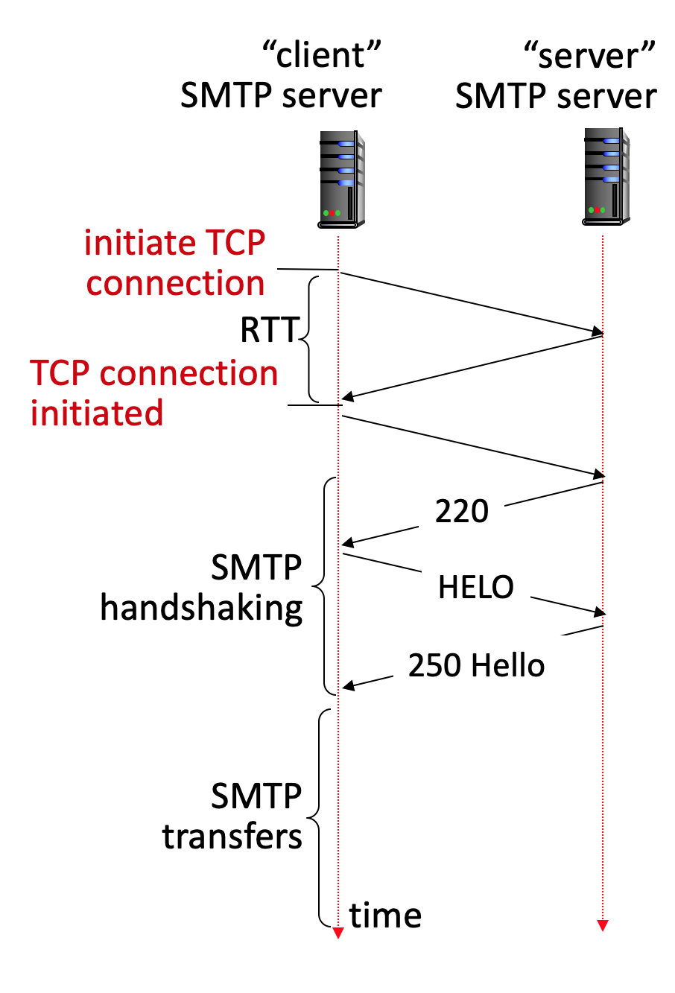
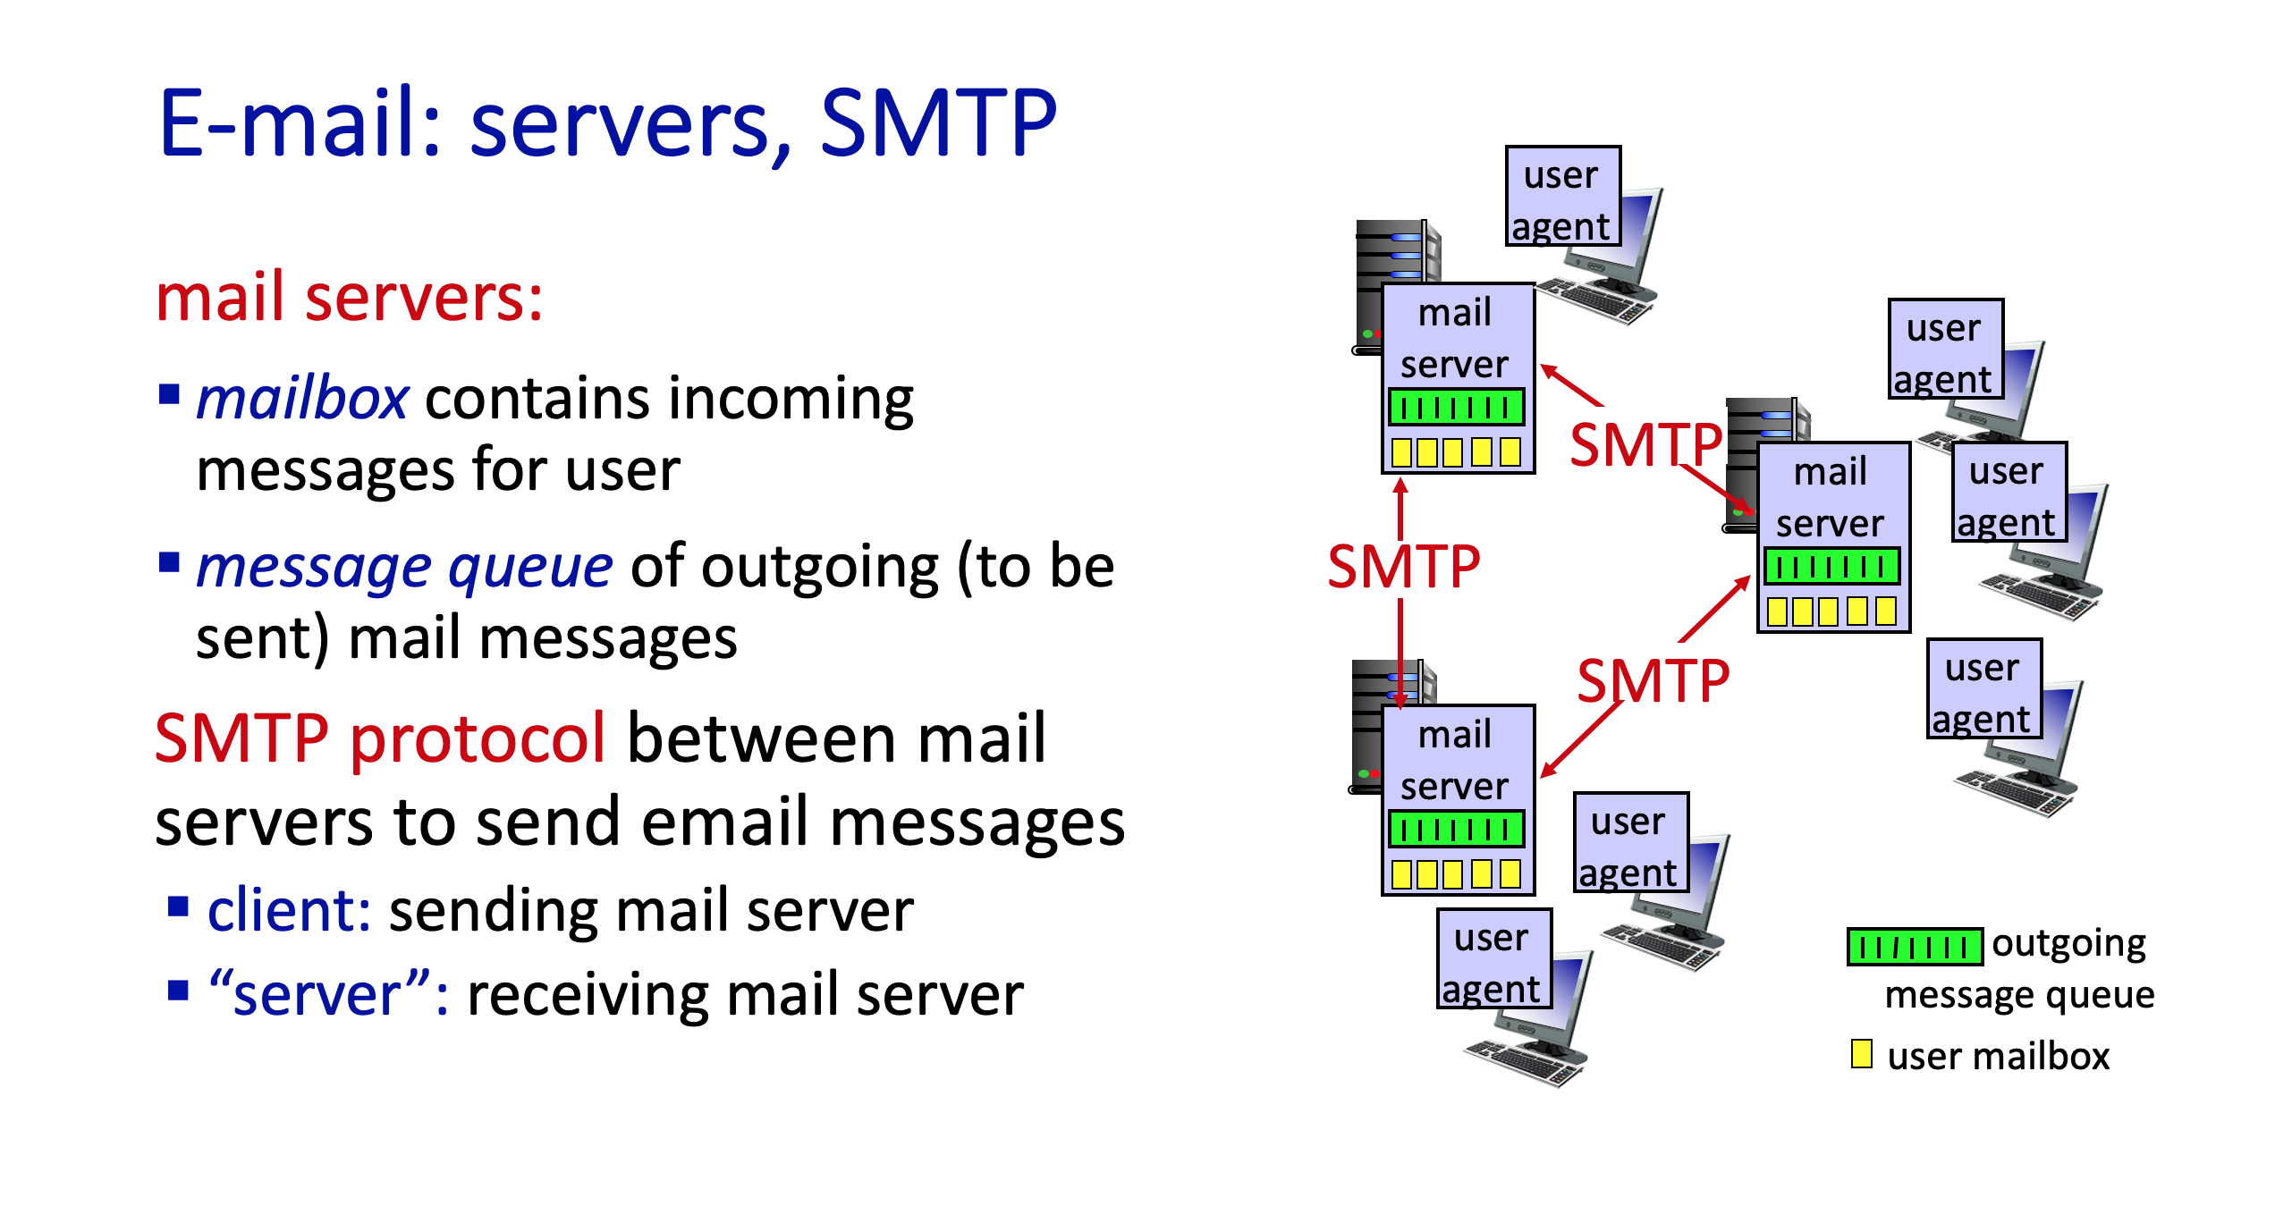
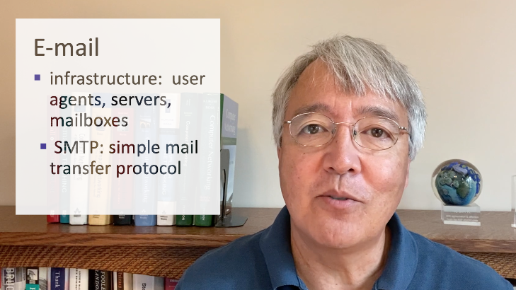
Network Applications
COMPSCI 453
Computer Networks
Professor Jim Kurose
Email: infrastructure, SMTP
Class textbook:
Computer Networking: A Top-Down Approach (8th ed.)
J.F. Kurose, K.W. Ross

